Slide 1
OLAP & Schemas

Slide 2
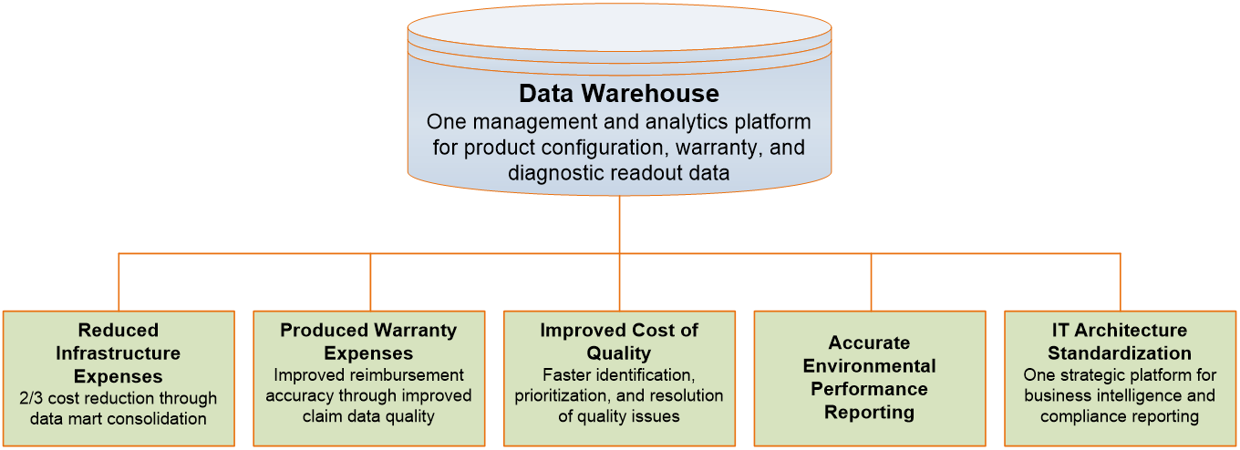
DW for Data-Driven Decision Making
An example of a DW supporting data-driven decision making in automotive industry

Slide 3
Task Happy bakery
Go to your logbooks and open happy bakery schema
In groups:
Add an extra relevant fact table
Add two extra relevant dimensions

Slide 4
Analysis of Data in DW
OLTP (Online Transaction Processing)
Capturing and storing data from ERP, CRM, POS, …
The main focus is on efficiency of routine tasks
OLAP (Online Analytical Processing)
Converting data into information for decision support
Data cubes, drill-down / rollup, slice & dice, …
Requesting ad hoc reports
Conducting statistical and other analyses
Developing multimedia-based applications

Slide 5
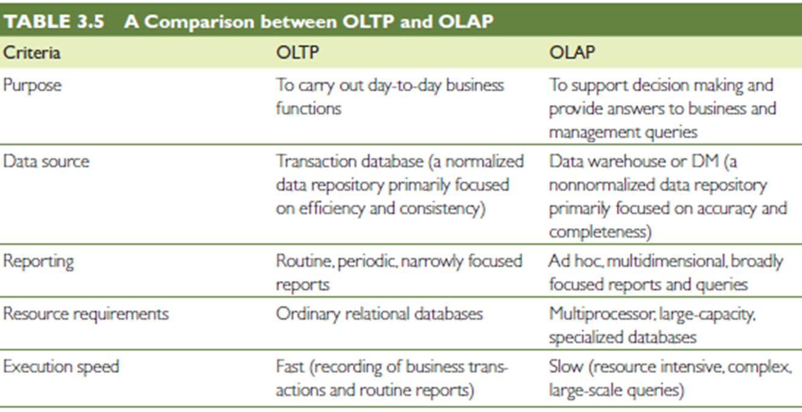
OLAP vs. OLTP

Slide 6
OLAP Operations
Slice - a subset of a multidimensional array
Dice - a slice on more than two dimensions
Drill Down/Up - navigating among levels of data ranging from the most summarized (up) to the most detailed (down)
Roll Up - computing all of the data relationships for one or more dimensions
Pivot - used to change the dimensional orientation of a report or an ad hoc query-page display

Slide 7
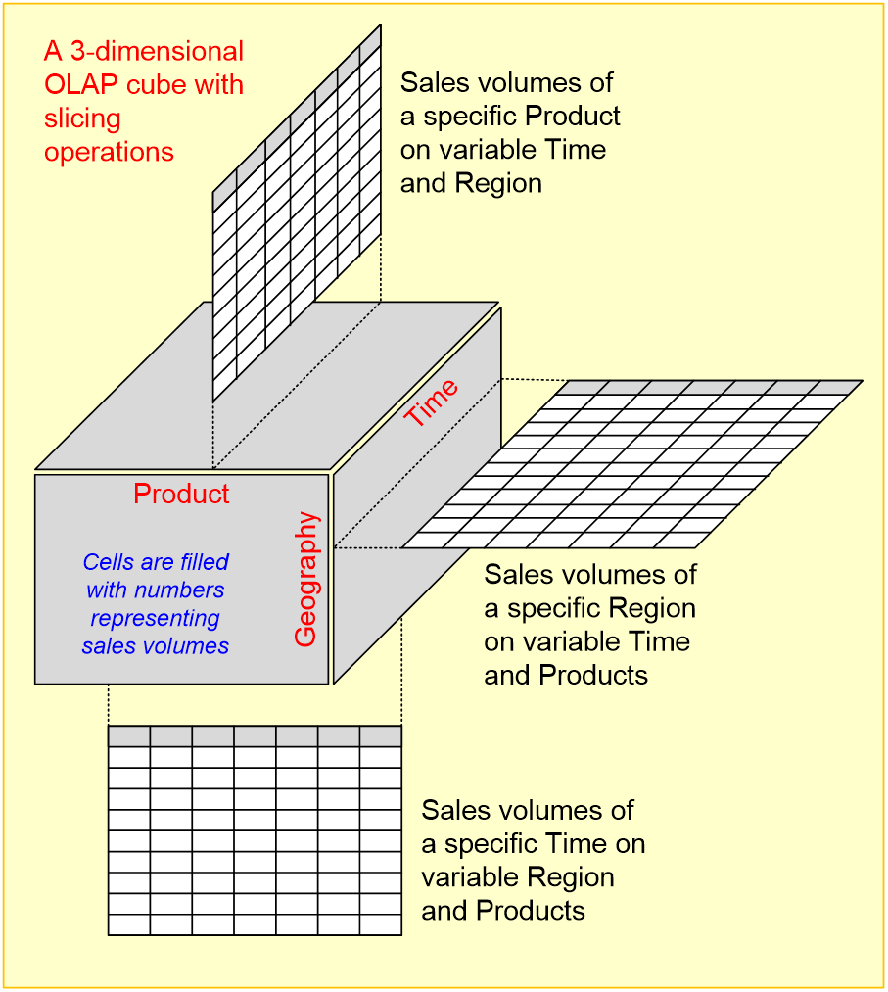
OLAP
Slicing Operations on a Simple Tree-Dimensional
Data Cube

Slide 8
SQL Tasks
Complete the logbook exercises 12-16 or complete the entire logbook if you are ahead.

